Slide 1
BSTT: A Bayesian Spatial-Temporal Transformer for Sleep Staging
Yuchen Liu, Ziyu Jia

Slide 2
Introduction
Significance of sleep - Restore bodily functions. - Synthesis of hormones needed by the body. - Effects of poor sleep - cognitive, psychological, physiological.
Current problems in the field of sleep staging - Manual sleep staging is time-consuming and labor-intensive. - Current automated sleep staging methods still have some drawbacks.

Slide 3
Related work
Existing work has achieved a good level of staging, but there are still shortcomings - Traditional machine learning methods require manually extracted features and rely on expert knowledge. - Early deep learning methods use CNN, RNN and other methods suffer from inadequate feature extraction. - Current more advanced deep learning methods extract both temporal and spatial features, but still do not model the spatial-temporal relationships of the brain.
Traditional machine learning methods
Early deep learning methods
Advanced deep learning methods
No modelling of spatial-temporal relationships
Rely on expert knowledge
Inadequate feature extraction

Slide 4
Challenges and solutions
Challenges - Traditional machine learning methods require manually extracted features and rely on expert knowledge. - Most advanced work considers only one aspect of the brain's spatial and temporal relations. - Existing methods cannot adaptively infer spatial-temporal relations of the brain under different sleep stages.
Solutions - Bayesian relational inference component : adaptively infer spatial-temporal relations of brain. - Spatial-temporal transformer architecture: simultaneously model spatial-temporal relations. - Experimental results: BSTT achieves the state-of-the-art in multiple sleep staging datasets. - Visual analysis: BSTT has a certain degree of interpretability for sleep staging.

Slide 5
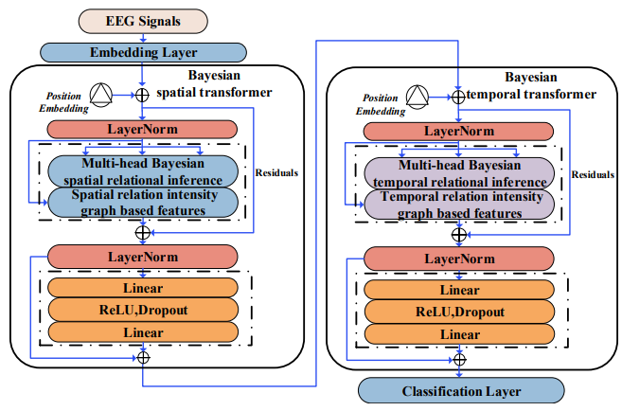
Methods
We propose Bayesian relation inference component - Infer the temporal and spatial relationships of the brain during sleep.
We design Bayesian spatial-temporal Transformer architecture - It can use the relation inferred by Bayesian relation inference component to capture spatial and temporal features.
The model has a degree of interpretability - The visual analysis shows that the model has a degree of interpretability.

Slide 6

Bayesian relation inference component
Step1:Generate edge embeddings.
Step2: Edge embedding coupling, we assume that the edges in the relation graph are sampled obeying a Bernoulli distribution with $n−>∞$ and $λ−>0$.
Step3: In order to make the generated graphs fit the downstream task better, we further generated relational graphs using a Gaussian graph transformation method.

Slide 7
Architecture of Transformer
The overall framework is the same as Transformer, but replaces its self-attention component with a Bayesian relational inference component.
The position embedding uses the classical sin and cos embedding.

Slide 8
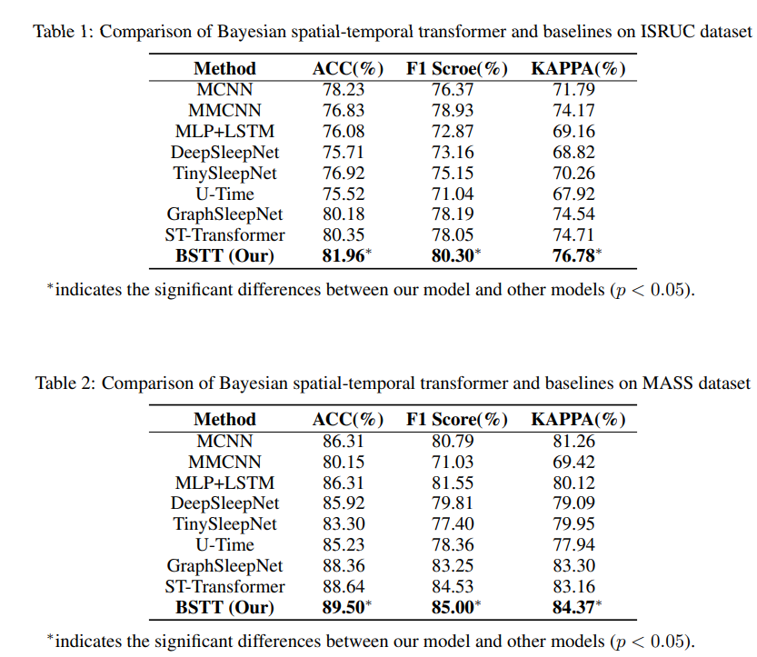
Experiments
Our model achieves SOTA performance - Our model achieve optimal performance on the ISRUC and MASS-SS3 datasets, respectively.

Slide 9
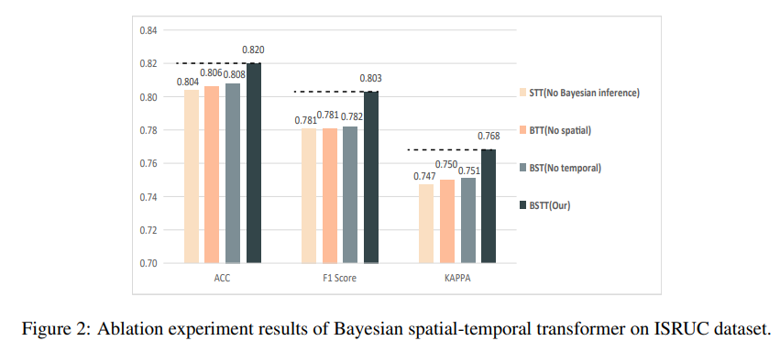
Ablation Experiment
The ablation experiment demonstrates the effectiveness of each component - We conduct ablation experiment on the Bayesian relation inference component, the Bayesian spatial transformer module, and the Bayesian temporal transformer module, respectively. The results of the models are reduced to varying degrees after removing these components.

Slide 10
Visual analysis
We visualize the spatial relationship graph on the MASS-SS3 dataset - It has been revealed that during light sleep, cerebral blood flow (CBF) and cerebral metabolic rate (CMR) are only about 3% to 10% lower than those of wakefulness while during deep sleep (Madsen & Vorstrup, 1991). Synaptic connection activity is directly correlated with CBF and CMR, which is consistent with our connection intensity graph.

Slide 11
Visual analysis
We visualize the temporal relationship graph on the MASS-SS3 dataset - Previous studies have shown that the stability of the unchanging period is stronger, and sleep instability is the basis of sleep transition (Bassi et al., 2009), which is consistent with our experimental results.

Slide 12
Conclusion
Conclusion - First attempt to combine Bayesian relational inference with spatial-temporal Transformer for sleep staging. - Effectively improves the efficiency of the sleep staging task model. - Extensive visual analysis experiments demonstrate that the proposed model has a certain degree of interpretability.
Future work - The relation intensity graphs generated by the Bayesian relation inference is consistent with the existing research and helps to reveal the potential working mechanism of our model. - BSTT is a general framework for inferring the spatial-temporal relationships of EEG signals. - It could be used for other EEG tasks such as emotion recognition or motor image classification.

Slide 13
Thanks！

